Slide 1

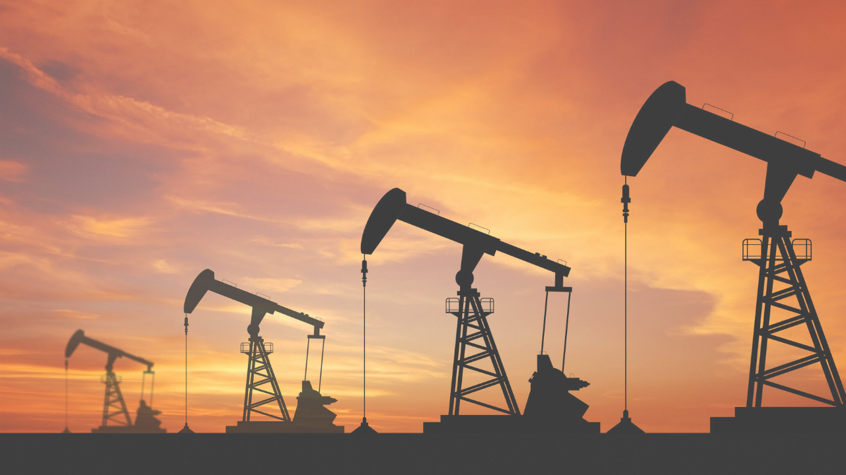
“Big Data application in Oil Upstream”
By: Heithem Lejmi
December 14th, 2018

Slide 2
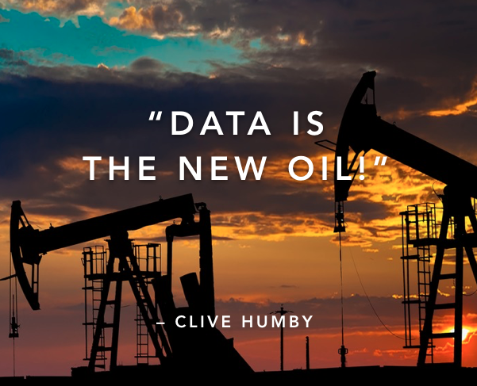

Slide 3
In fact, Data is like crude oil !
It’s valuable, but if unrefined it cannot be used.
“Big Data is the refined oil of the new economy”

Slide 4
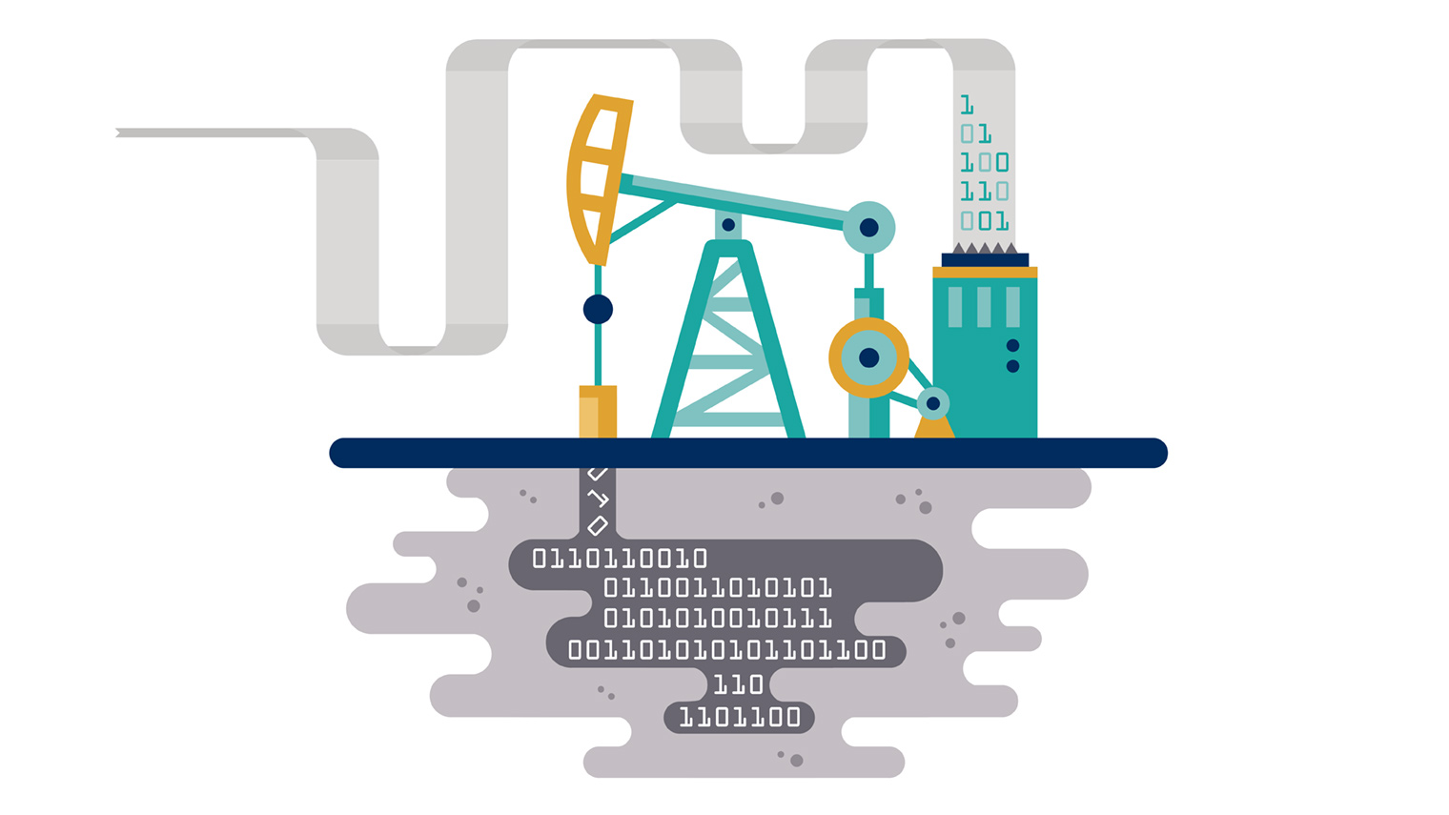
But what about Big Data generated by the Petroleum Industry and particularly its upstream segment?

Slide 5
Oil & Gas upstream stage is complex, data-driven business with data volumes growing exponentially.
The aim of this presentation is to show how Big Data can be used to gain valuable operational insight in the Oil & Gas industry and to assist in decision-making in different activities of its upstream sector.

Slide 6
OUTLINE
1.
BIG DATA DEFINITION
2.
APPLICATION OF BIG DATA IN THE OIL UPSTREAM
3.
BIG DATA TECHNIQUES APPLIED IN THE OIL AND GAS INDUSTRY
4.
ADVANTAGES OF BIG DATA APPLICATION IN OIL UPSTREAM
5.
CONCLUSION

Slide 7
OUTLINE
BIG DATA DEFINITION
1.
2.
APPLICATION OF BIG DATA IN THE OIL UPSTREAM
3.
BIG DATA TECHNIQUES APPLIED IN THE OIL AND GAS INDUSTRY
4.
ADVANTAGES OF BIG DATA APPLICATION IN OIL UPSTREAM
5.
CONCLUSION

Slide 8
Big Data Definition
“Big Data technologies describe a new generation of technologies and architectures, designed to economically extract value from very large volumes of a wide variety of data, by enabling high velocity capture, discovery and analysis, while ensuring their veracity by an automatic quality control in order to obtain a big value”.
(Feblowitz, 2012)

Slide 9
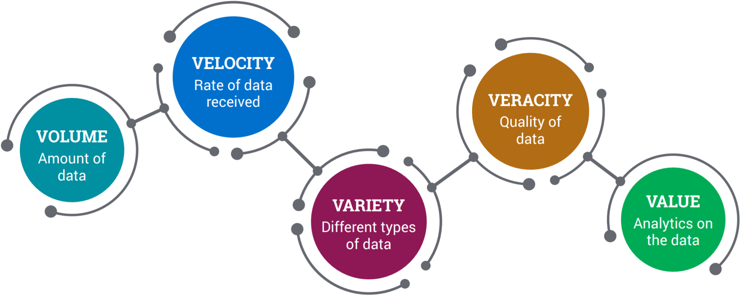
Big Data Definition
Big Data is characterized by the “5V” concept:

Slide 10
OUTLINE
1.
BIG DATA DEFINITION
2.
APPLICATION OF BIG DATA IN THE OIL UPSTREAM
3.
BIG DATA TECHNIQUES APPLIED IN THE OIL AND GAS INDUSTRY
4.
ADVANTAGES OF BIG DATA APPLICATION IN OIL UPSTREAM
5.
CONCLUSION

Slide 11
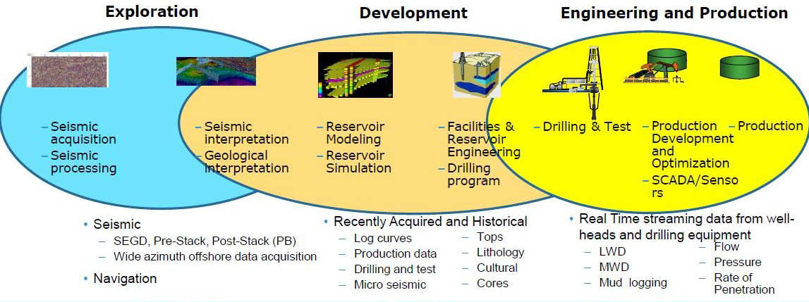
Application of Big Data in the Oil Upstream
Upstream is no stranger to Big Data, the Upstream Data is also characterized by the 5V concept:
Volume
Velocity
Variety
Veracity
Value
Notes:
Oil & Gas Companies conduct advanced geophysics modeling and simulation to support operations where 2D, 3D & 4D Seismic generate significant data during exploration phases. They closely monitor the performance of their operational assets. To do this, they use tens of thousands of data-collecting sensors in subsurface wells and surface facilities to provide continuous and real-time monitoring of assets and environmental conditions.

Slide 12
Application of Big Data in the Oil Upstream
The Upstream stage receives a huge amount of data in various and increasingly complex forms, making it a real challenge and struggle to collect, interpret, and leverage the disparate data while ensuring its quality and getting useful information from it.
All these reasons were urging the use of Big Data technology in Oil & Gas industry as the most suitable technique that could allow the best management of the different types of these fast growing data.

Slide 13
OUTLINE
1.
BIG DATA DEFINITION
2.
APPLICATION OF BIG DATA IN THE OIL UPSTREAM
3.
BIG DATA TECHNIQUES APPLIED IN THE OIL AND GAS INDUSTRY
4.
ADVANTAGES OF BIG DATA APPLICATION IN OIL UPSTREAM
5.
CONCLUSION

Slide 14
Big Data techniques applied in the Oil and gas industry
Many companies have started the application of Big Data in the Oil & Gas field :
– Chevron proof-of-concept using Hadoop (IBM BigInsights) for seismic data processing ;
– Shell piloting Hadoop in Amazon Virtual Private Cloud (Amazon VPC) for seismic sensor data ;
– Petroleum Engineering department of the University of Stavanger data acquisition performance study using Hadoop….

Slide 15
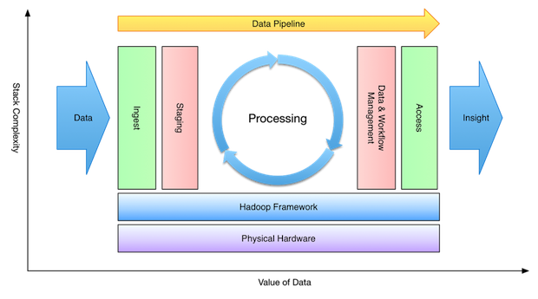
Big Data techniques applied in the Oil and gas industry
Hadoop Ecosystem is a platform / framework which is extremely popular for handling and analyzing large sets of data.

Slide 16
Big Data techniques applied in the Oil and gas industry
We can consider Hadoop framework as a suite which encompasses a number of components (ingesting, storing, analyzing and maintaining) inside it.

Slide 17
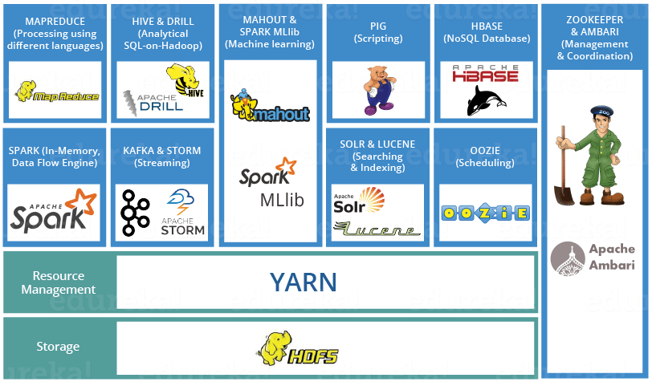
Big Data techniques applied in the Oil and gas industry

Slide 18

Big Data techniques applied in the Oil and gas industry
Hadoop Distributed File System is the core component (the backbone of Hadoop Ecosystem).
HDFS is the one, which makes it possible to store different types of large data sets.

Slide 19

Big Data techniques applied in the Oil and gas industry
YARN = ”Yet Another Resource Negotiator”
YARN is considered as the brain of the Hadoop Ecosystem. It performs all the data processing activities.

Slide 20

Big Data techniques applied in the Oil and gas industry
MapReduce : ‘Data processing using programming’
It is the core component of processing in a Hadoop Ecosystem .
MapReduce is a software framework which helps in writing applications that processes large data sets using distributed and parallel algorithms inside Hadoop environment.
Notes:
it provides the logic of processing.

Slide 21

Big Data techniques applied in the Oil and gas industry
HIVE: ’Data Processing Services using Query (SQL-like)’
HIVE is a data warehousing component which performs reading, writing and managing large data sets in a distributed environment using SQL-like interface.
Notes:
it provides the logic of processing.

Slide 22

Big Data techniques applied in the Oil and gas industry
Mahout: ’Machine Learning’
Mahout provides an environment for creating machine learning applications.
Notes:
it provides the logic of processing.

Slide 23

Big Data techniques applied in the Oil and gas industry
Apache Spark:
It is a framework for real time data analytics in a distributed computing environment.
Notes:
it provides the logic of processing.

Slide 24

Big Data techniques applied in the Oil and gas industry
Zookeeper :’Management & coordination’
Apache Zookeeper is the coordinator of any Hadoop job which includes a combination of various services in a Hadoop Ecosystem.
Notes:
it provides the logic of processing.

Slide 25
OUTLINE
1.
BIG DATA DEFINITION
2.
APPLICATION OF BIG DATA IN THE OIL UPSTREAM
3.
BIG DATA TECHNIQUES APPLIED IN THE OIL AND GAS INDUSTRY
4.
ADVANTAGES OF BIG DATA APPLICATION IN OIL UPSTREAM
5.
CONCLUSION

Slide 26
Advantages of Big Data application in Oil upstream
Deploying these Big Data methods in the Oil & Gas industry enable a better understanding and leveraging of data in the upstream segment and translate the crude data into actionable insights.
Applying Big Data technology ensures the optimzation of all phases of oil upstream (exploration, field development, production..)
As Big Data allows saving time, reducing costs and improving safety throughout the oil upstream operations.

Slide 27
Advantages of Big Data application in Oil upstream
Exploration: Reducing the duration of large scale data processing leads to speeding up the geological and hydrodynamic modelling.
Reservoir engineering: Increasing the value and accuracy of recorded data improves the outcome of reservoir simulation models and production forecast.
Drilling: Big Data interfers in improving drill accuracy and safety , as well as optimizing the drills parameters and reducing the drill downtime.
Production: The conclusions obtained from Big Data analysis allows a better enhanced oil recovery and well performance.

Slide 28
OUTLINE
1.
BIG DATA DEFINITION
2.
APPLICATION OF BIG DATA IN THE OIL UPSTREAM
3.
BIG DATA TECHNIQUES APPLIED IN THE OIL AND GAS INDUSTRY
4.
ADVANTAGES OF BIG DATA APPLICATION IN OIL UPSTREAM
5.
CONCLUSION

Slide 29
Conclusion

Slide 30
Thank You For Your Attention

